Slide 1

7th Grade Accelerated Math
Unit 1, Lesson 8 Determining Solutions to Inequalities Volume 1, pg. 46

Slide 2


Benchmark
MA.8.AR.2.2
Solve two-step linear inequalities in one variable and represent solutions algebraically and graphically.
volume 1, pg. 46

Slide 3
Integrated Mathematical Thinking and Reasoning Standards
MA.K12.MTR.1.1 Actively participate in effortful learning both individually and collectively.
MA.K12.MTR.2.1 Demonstrate understanding by representing problems in multiple ways.
MA.K12.MTR.4.1 Engage in discussions that reflect on the mathematical thinking of self and others.
MA.K12.MTR.5.1 Use patterns and structure to help understand and connect mathematical concepts.
MA.K12.MTR.6.1 Assess the reasonableness of solutions.
volume 1, pg. 46

Slide 4

Learning Targets
I can determine which value from a set of values makes an inequality true.
I can determine if a value on a number line represents a solution set.
I can solve inequalities and represent solutions on a number line.
volume 1, pg. 46

Slide 5

Warm-Up
volume 1, pg. 47

Slide 6
1.8.1 Warm-Up: Careers - Forester
Foresters have a wide range of duties, depending on who their employer is. Some primary duties of foresters are drawing up plans to regenerate forested lands, monitoring the progress of those lands, and supervising tree harvests. Another duty of a forester is devising plans to keep forests free from disease, harmful insects, and damaging wildfires.
1. Why do you think being an effective communicator and a team player is essential to the job?
2. Describe a time when you had to be an effective communicator and team player.
volume 1, pg. 47

Slide 7

Exploration
volume 1, pg. 47

Slide 8

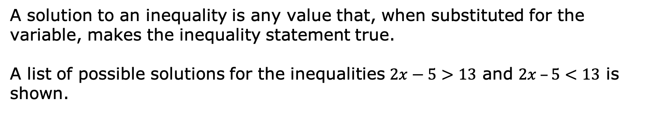
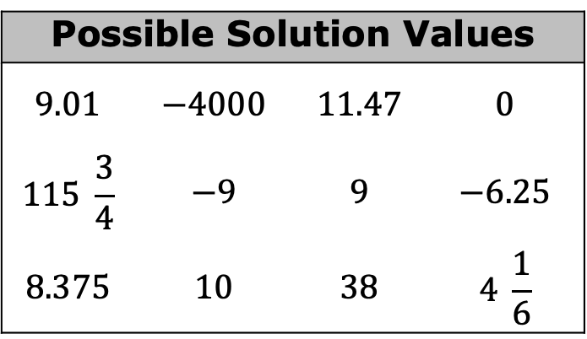
1.8.2 Exploration: Is It a Solution?
A solution to an inequality is any value that, when substituted for the variable, makes the inequality statement true.
A list of possible solutions for the inequalities $2x−5>13$ and $2x –5<13$ is shown.
Possible Solution Values
$$9.01$$ | $$−4000$$ | $$11.47$$ | $$0$$
$$115 \frac{3}{4}$$ | $$−9$$ | $$9$$ | $$−6.25$$
$$8.375$$ | $$10$$ | $$38$$ | $$4 \frac{1}{6}$$
volume 1, pg. 47

Slide 9
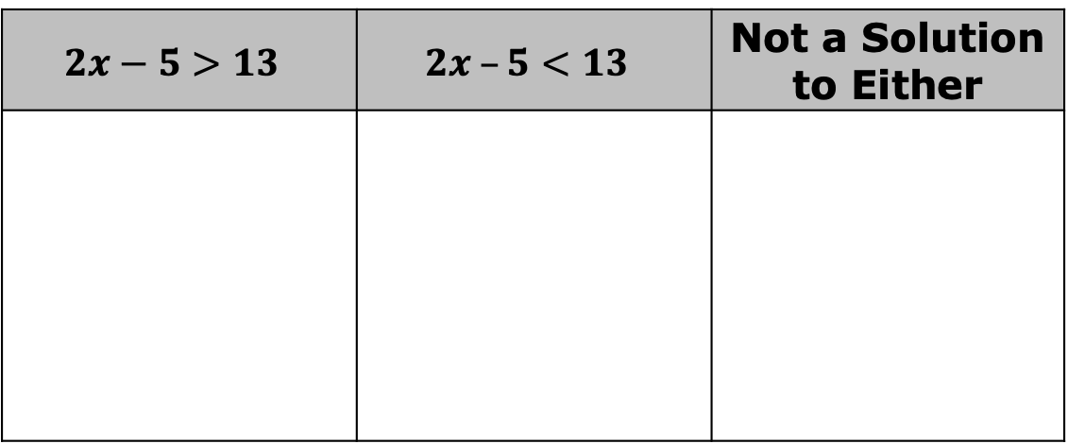
Determine whether each of the possible values is a solution to the given inequalities.
Record the solutions in the table.
$$2x−5>13$$ | $$2x –5<13$$ | Not a Solution to Either
volume 1, pg. 47

Slide 10

b. Explain the strategy you used to identify solutions.
2. Discuss with your partner why an inequality has infinitely many solutions.
An inequality has infinite solutions and can be
represented on a number line.
volume 1, pg. 47

Slide 11
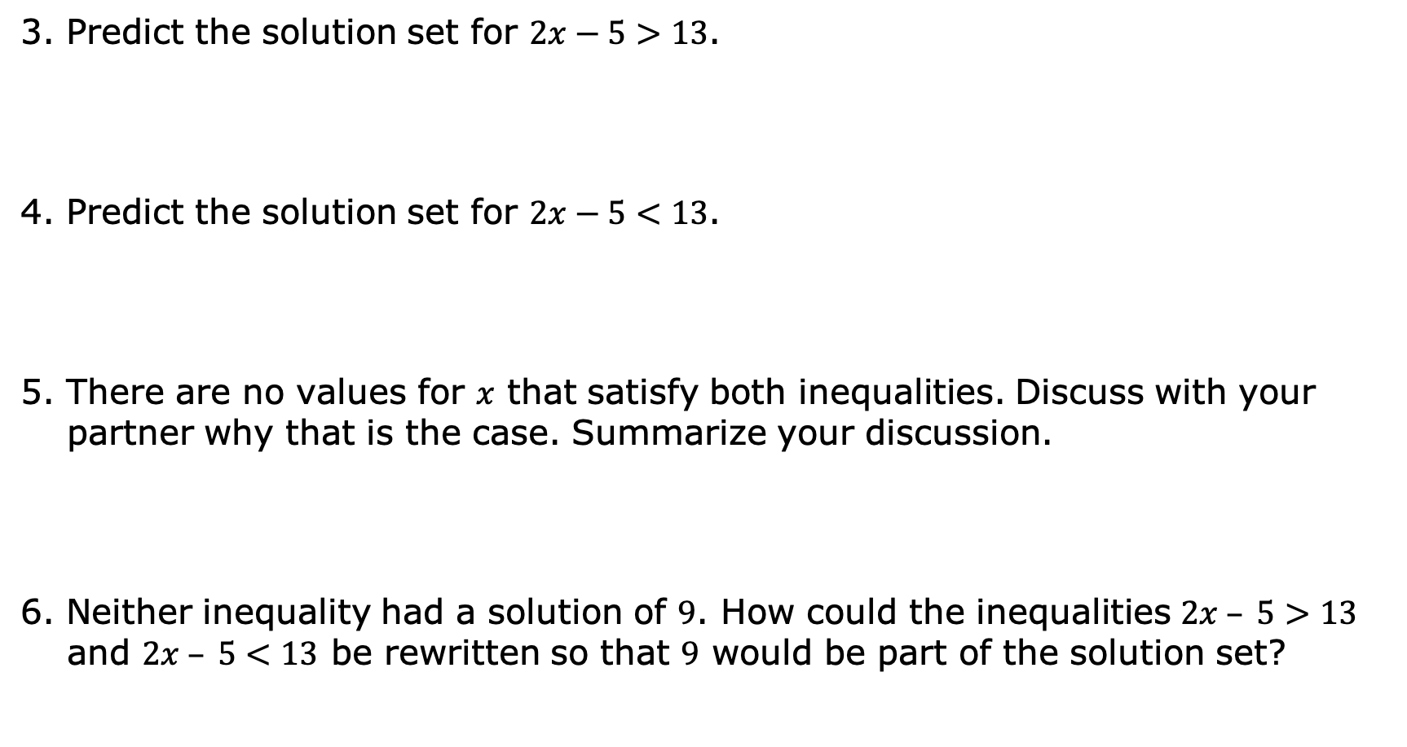
3. Predict the solution set for $2x−5>13$.
4. Predict the solution set for $2x−5<13$.
5. There are no values for $x$ that satisfy both inequalities. Discuss with your partner why that is the case. Summarize your discussion.
6. Neither inequality had a solution of $9$. How could the inequalities $2x – 5>13$ and $2x – 5<13$ be rewritten so that $9$ would be part of the solution set?
volume 1, pg. 48

Slide 12

Guided Practice
volume 1, pg. 48

Slide 13

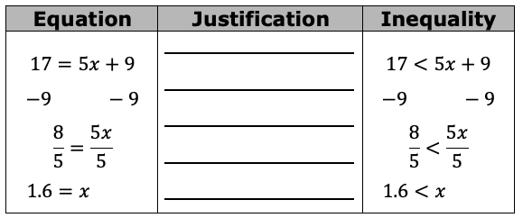
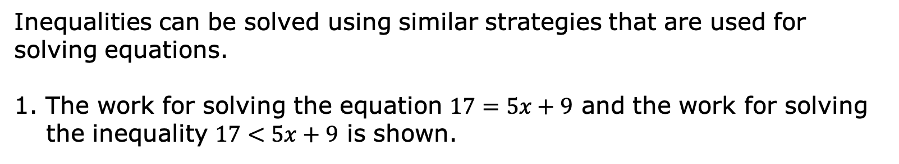
1.8.3 Guided Practice: Solving Two-Step Inequalities
Inequalities can be solved using similar strategies that are used for solving equations.
1. The work for solving the equation $17=5x+9$ and the work for solving the inequality $17<5x+9$ is shown.
volume 1, pg. 48

Slide 14
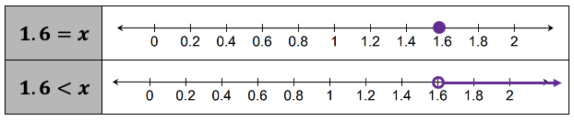
a. Complete the table with the justification of each step used for solving the equation and the inequality.
The solution for the equation and the solution set for the inequality is shown.
b. Discuss with your partner the similarities and differences between solving and graphing the solutions for equations and inequalities. Summarize your discussion.
volume 1, pg. 48

Slide 15

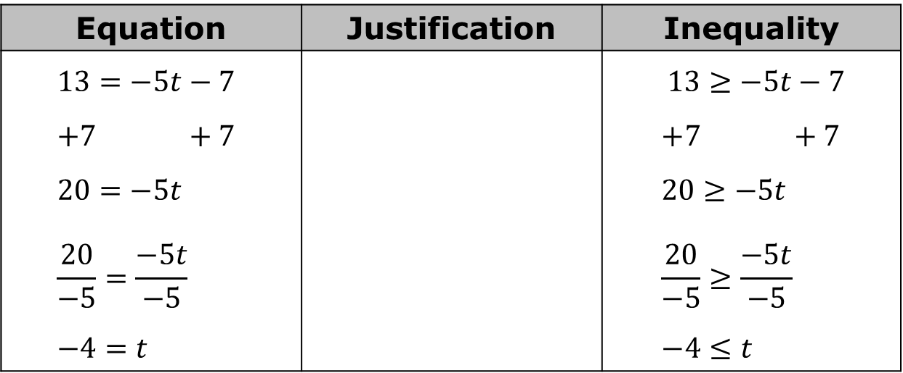
2. The work for solving the equation $13=−5t−7$ and the inequality $13≥−5t−7$ is shown.
Complete the table with the justification of each step used for solving the equation and the inequality.
b. How did the final step of solving the inequality $13≥−5t−7$ differ from the final step of solving the inequality $17<5x+9?$
Equation | Justification | Inequality
$$13=−5t−7 \\ +7 +7 \\ 20=−5t \\ \frac{20}{−5}=\frac{−5t}{−5} \\ −4=t$$ |  | $13≥−5t−7$ $$+7 +7 \\ 20≥−5t \\ \frac{20}{−5}≥\frac{−5t}{−5} \\ −4≤t$$
volume 1, pg. 49

Slide 16
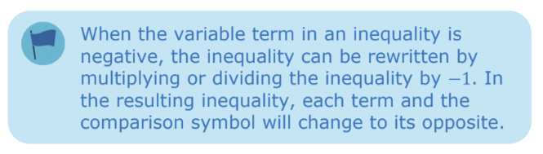

3. Solve each inequality and graph the solution.
$2−\frac{a}{6}≥−4$
$13≥−5t−7$
volume 1, pg. 49

Slide 17

Your Turn
volume 1, pg. 50

Slide 18

1.8.4 Your Turn!
1. Solve each inequality and graph the solution.
$56≥8x+21$
$−2.7−0.5t>8.3$
$6+\frac{3}{4}k<−12$
volume 1, pg. 50

Slide 19

Collaboration
volume 1, pg. 50

Slide 20

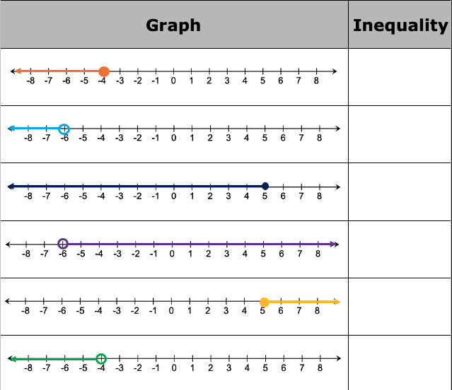
1.8.5 Collaboration: Matching Inequalities
Work with your partner to match each of the given inequalities to their graph of possible solutions.
1. Record your matches in the table.
volume 1, pg. 50

Slide 21
2. What strategies did you use to match each inequality to its graph?
volume 1, pg. 50

Slide 22

Wrap-Up
volume 1, pg. 51

Slide 23
1.8.6 Wrap-Up: Cool Down
Explain a way that you can determine if a solution is correct for a given inequality.
How do you know if the circle should be open or closed when graphing an inequality?
volume 1, pg. 51

